Slide 1
Obesity prediction model
Dalia Debbarma
Prajan Arun
Shagun Gupta
Shashank Sant

Slide 2
PROBLEM Definition
Individuals with different vitals have varied lifestyle choices and food consumption habits, that leads to condition of obesity.
POSSIBLE FACTORS AFFECTING OBESITY:
Weight
From the dataset:
Weight
Height
Gender
Frequent consumption of high caloric food (FAVC)
Frequency of consumption of vegetables (FCVC)
Number of main meals (NCP)
Consumption of food between meals (CAEC)
Consumption of water daily (CH20)
Consumption of alcohol (CALC)
Height
Gender
Eating Habits
Lifestyle

Slide 3
ABOUT THE DATASET
The dataset describes obesity levels based on below factors –
Eating habits of an individual
Physical characteristics such as age, weight, gender
Lifestyle habits such as smoking, drinking, transportation mode
The data contains 17 attributes and 2111 records
CLASSIFICATION
Overweight level I
Overweight level II
Obesity Type II
Obesity Type I
Obesity Type III)

Slide 4
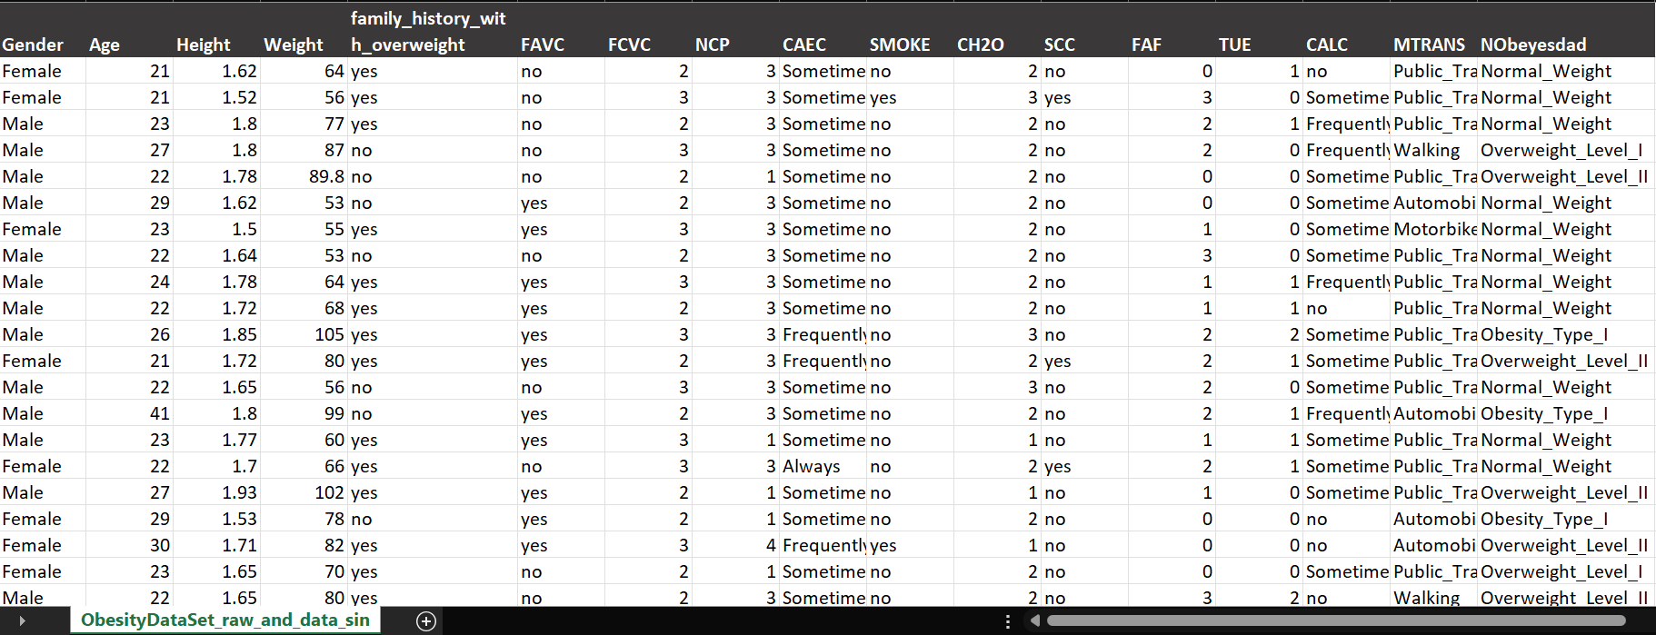
DATASET PREVIEW

Slide 5
Data Visualizations and Descriptive statistics

Slide 6
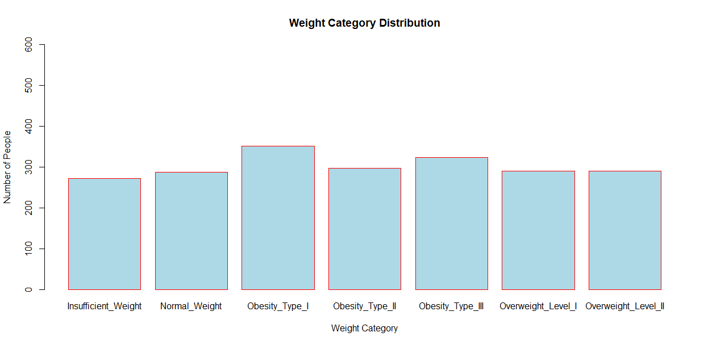
Data Visualizations and Descriptive statistics
Insufficient_Weight 272
Normal_Weight 287
Obesity_Type_I 351
Obesity_Type_II 297
Obesity_Type_III 324
Overweight_Level_I 290
Overweight_Level_II 290

Slide 7
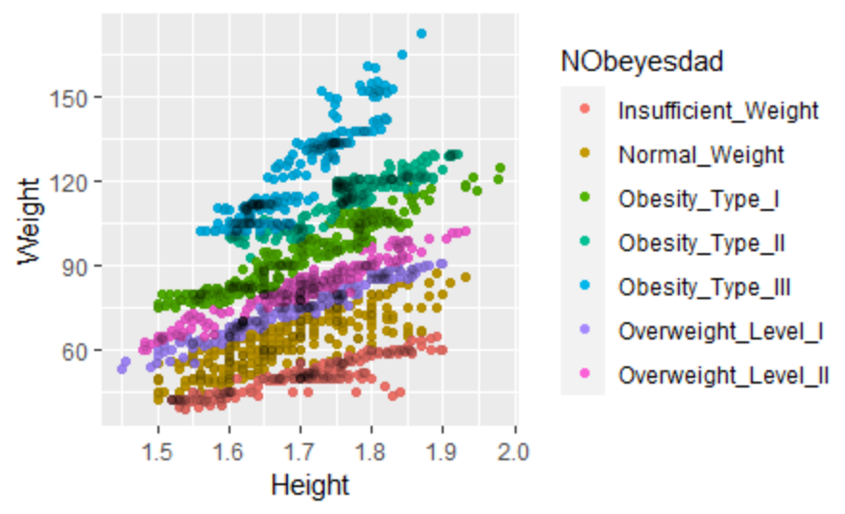
Data Visualizations and Descriptive statistics

Slide 8
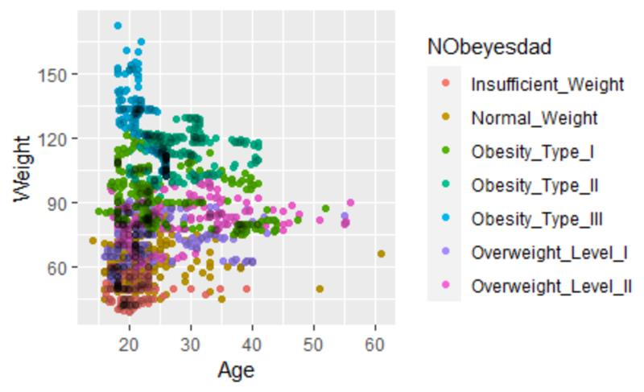
Data Visualizations and Descriptive statistics

Slide 9
Model preparation

Slide 10
Knn model
Model 1
K- value= 45
Test data sample = 110
Model 2
Attributes
Height, Weight
Reveals inaccuracy in 8 out of 110 cases
Attributes
Height, Weight, Alcohol consumption, Smoking
Reveals inaccuracy in 18 out of 110 cases

Slide 11
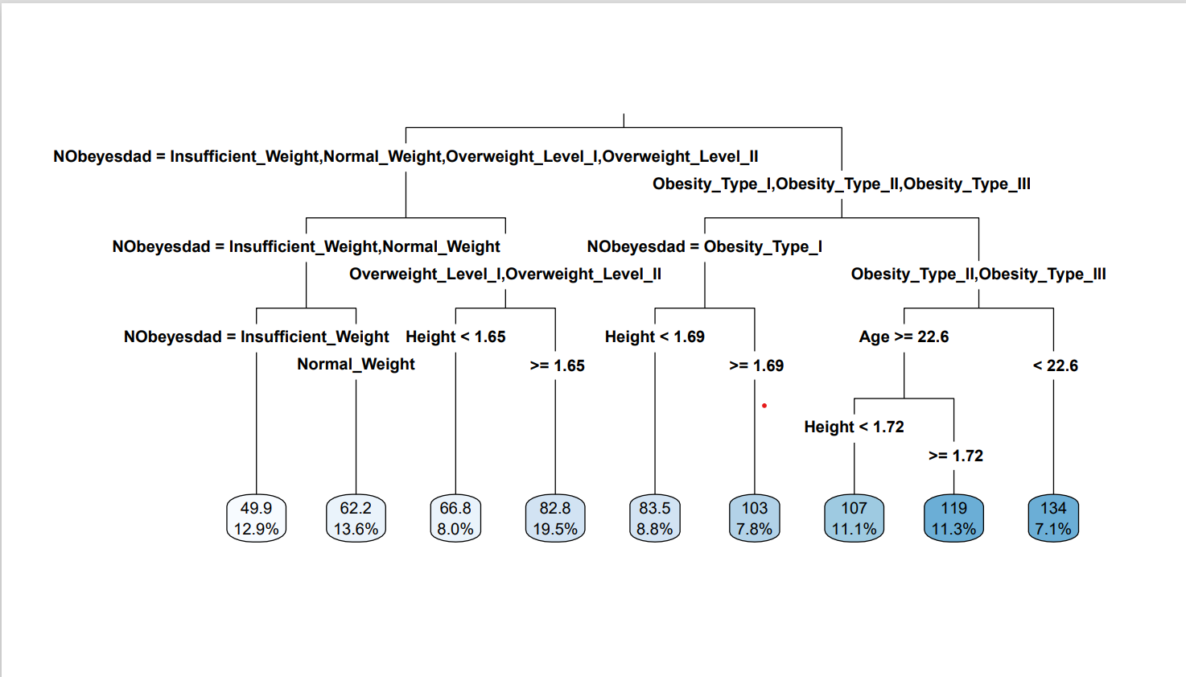
regression tree
Here we are predicting the weight using features like age, weight, height, gender, smoking
Our model is using the rpart function and have allowed the function to decide the factors required to build a classification tree
We have used rpart.plot function to get a pictorial representation
Method used is ‘anova’

Slide 12
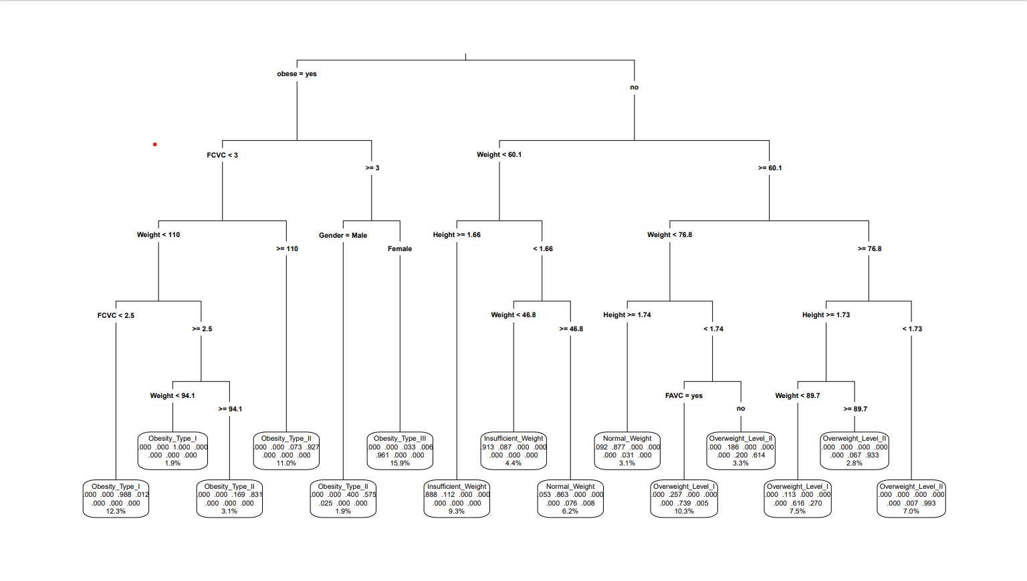
Classification TREE
Here we are trying to classify the weight category using features like age, weight, height, gender, smoking
Our model is using the rpart function and have allowed the function to decide the factors required to build a classification tree
We have used rpart.plot function to get a pictorial representation
Method used is ‘class’

Slide 13
Results

Slide 14
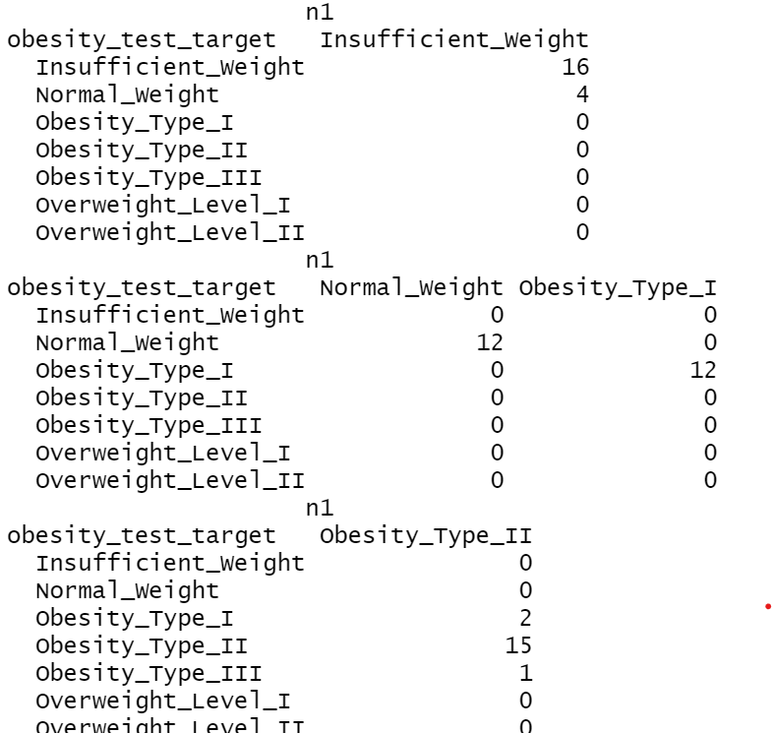
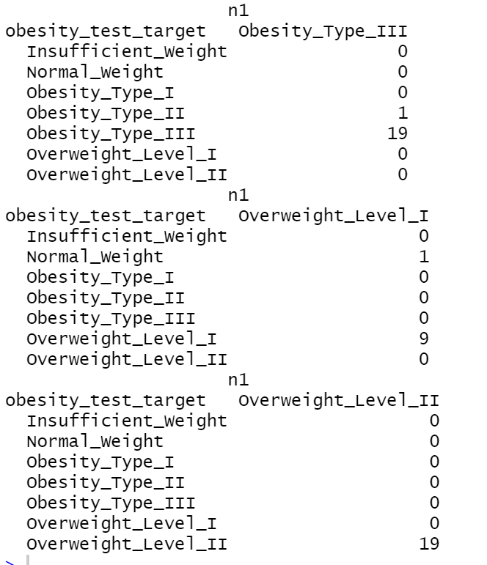
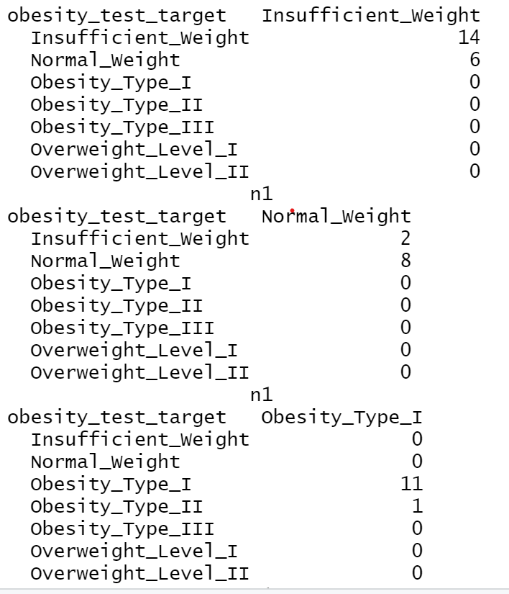
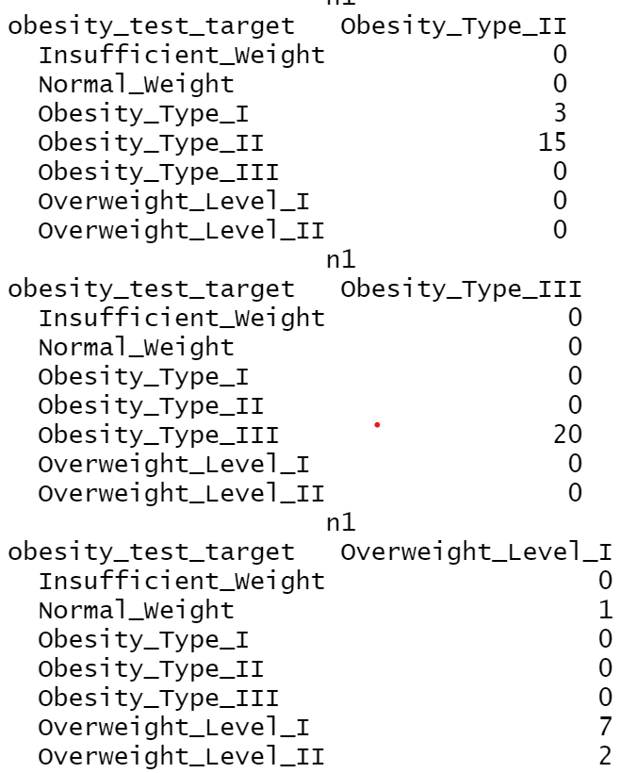
KNN
Model 1: Reveals inaccuracy in 8 out of 110 cases
Model 2: Reveals inaccuracy in 18 out of 110 cases

Slide 15
Regression TREE

Slide 16
Classification tree

Slide 17
Conclusion
Comparison from KNN Model 1&2, We can say that consumption of alcohol and smoking doesn’t solely contribute to obesity condition.
From the given individual characteristics, Using regression tree model we can predict weight range.
From the given individual characteristics, Using classification tree model we can predict weight category.

Slide 18
THANK YOU

